Slide 1
AI Techniques for Predictive Maintenance

Slide 2
Anomaly Detection
Anomaly detection is the key step for predictive maintenance
Anomaly detection is the task of finding observations that do not conform to the normal
Different Approaches – Anomaly Detection
Supervised Learning
Support Vector Machines
Artificial Neural Networks
Unsupervised Learning
Principal Component Analysis
Clustering
Semi-Supervised Learning
Autoencoder

Slide 3
Dataset Description
IMS (Intelligent Maintenance Systems) Bearing Dataset
Also known as NASA PCoE (Prognastics Centre of Excellence) Bearing Dataset
Test Rig Setup
Four bearings were installed on a shaft. The rotation speed was kept constant at 2000 RPM by an AC motor coupled to the shaft via rub belts.
A radial load of 6000 lbs. is applied onto the shaft and bearing by a spring mechanism. All bearings are force lubricated.

Slide 4
Dataset Description
Bearing : Rexnord ZA-2115 double row bearings
Accelerometers: PCB 353B33 High Sensitivity Quartz ICP accelerometers
Accelerometers are used to sense vibrations
Dataset describes test to failure experiments
All failures occurred after exceeding designed life time of the bearing which is more than 100 million revolutions.

Slide 5
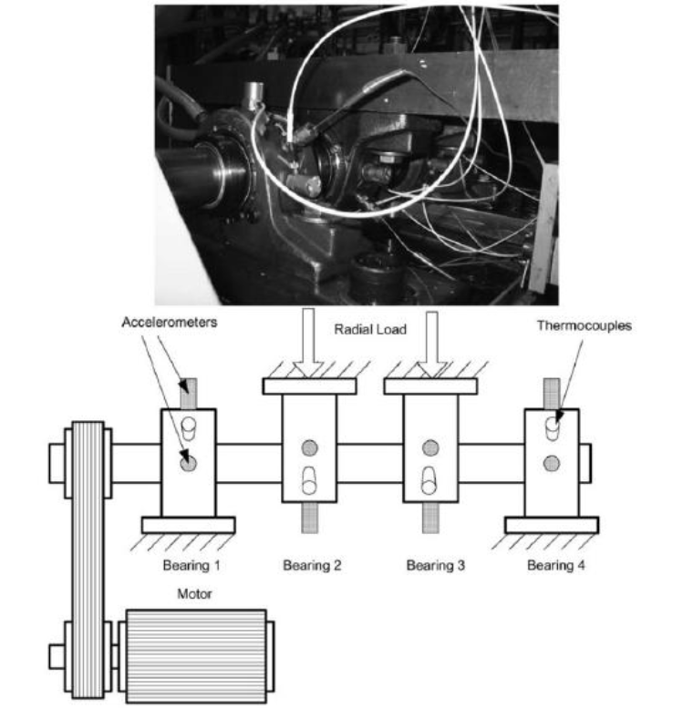
Test Rig Setup

Slide 6
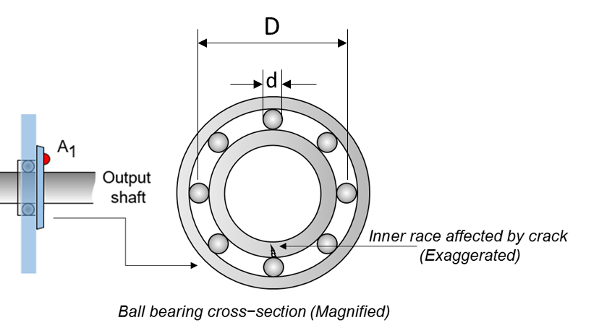
Bearing - Image

Slide 7
Dataset Description
Dataset consists of 3 sets of Data. (3 Tests)
Each data set consists of individual files that are 1-second vibration signal snapshots recorded at specific intervals.
Each file consists of 20,480 points with the sampling rate set at 20 kHz.

Slide 8
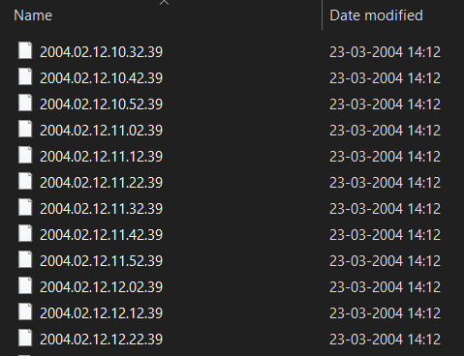
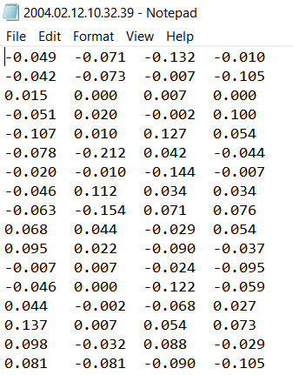
Dataset
The file name indicates when the data was collected. Each record (row) in the data file is a data point.

Slide 9
 | Set No. 1 | Set No. 2 | Set No. 3
Recording Duration | October 22, 2003 12:06:24 to November 25, 2003 23:39:56 | February 12, 2004 10:32:39 to February 19, 2004 06:22:39 | March 4, 2004 09:27:46 to April 4, 2004 19:01:57
No. of files | 2156 | 984 | 4448
Channel Arrangement (Accelerometer) (Ch – Channel) | Bearing 1 – Ch 1&2; Bearing 2 – Ch 3&4; Bearing 3 – Ch 5&6; Bearing 4 – Ch 7&8. | Bearing 1 – Ch 1; Bearing2 – Ch 2; Bearing3 – Ch3; Bearing 4 – Ch 4.
File Recording Interval: | Every 10 minutes
Description | Inner race defect occurred in bearing 3 and roller element defect in bearing 4. | Outer race failure occurred in bearing 1. | Outer race failure occurred in bearing 3.
Note: In this work, we are considering only Set No. 2

